Slide 1
Framework - Generic Extracts and Data Governance Metrics - II
- Srikrishna Bingi
www.exusia.com

Slide 2
Framework - Generic Extracts and Data Governance Metrics - II
Topics Covered previously:
  Process overview - Generic Extracts and Governance Metrics.
  Extraction Mechanisms - ‘Output’ module vs ‘Non-output’ module.
  Detailed File and Metrics File Generation process.
  Different Governance Metrics covered:
    ‘Adoption’ Category
    ‘Completion’ Category
    ‘Activity’ Category
    ‘Process’ Category

Slide 3

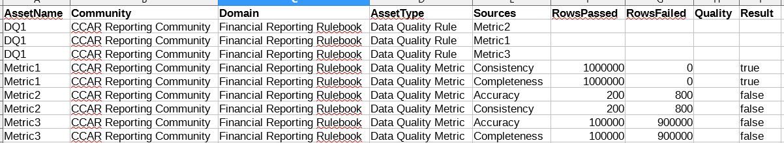
Framework - Generic Extracts and Data Governance Metrics
Data Governance Metrics Generation – ‘Quality’ Category
  Uses ‘Output’ module approach to fetch the ‘Detailed’ information.
  Fetches data quality metrics defined in DGC for a specific asset.

Slide 4
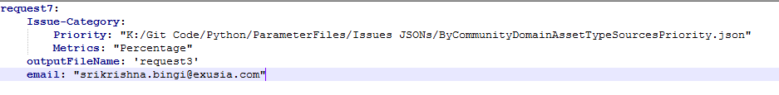
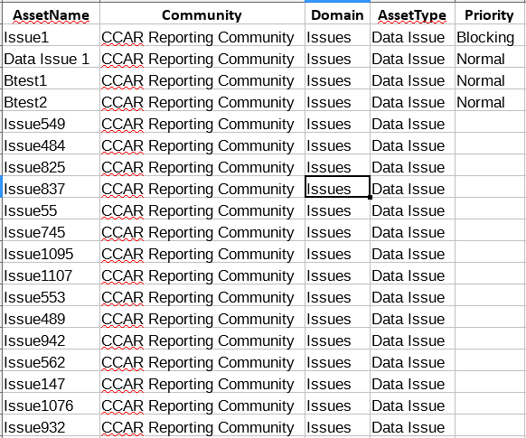
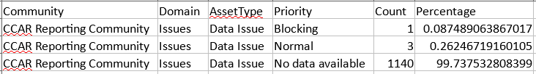
Framework - Generic Extracts and Data Governance Metrics
Data Governance Metrics Generation – ‘Issue’ Category
  Uses ‘Output’ module approach to fetch the ‘Detailed’ information.
  Fetches data issues logged by users in DGC.

Slide 5
Framework - Generic Extracts and Data Governance Metrics
Scripts used:
  ‘Main.py’ - Main script that takes in parameter file to be processed.
  ‘API Method.py’ - API script that helps get and post data to Collibra.
  ‘Asset.py’ - Groups methods performed on assets.
  ‘CreateDataFile.py’ - Groups methods related to storing data in files (excel).
  ‘CreateMap.py’ - Groups methods related to processing conditions specified for non-output module approach.
  ‘Job.py’ - Groups methods required to fetch data using output module.
  ‘ProcessMetrics.py’ - Groups methods that are used for generating metrics.
  ‘ProcessMaps.py’ - Groups methods that work in conjuction with methods in ‘CreateMap.py’.
  ‘RelationFilter.py’ - Groups methods that help processing relations for ‘ProcessMaps.py’.
  ‘ ‘ComplexRelationFilter.py’ - Groups methods that help processing complex relations for ‘ProcessMaps.py’.
  ‘CollibraError.py’ - Error handling script.

Slide 6
Framework - Generic Extracts and Data Governance Metrics
Generating metrics using Redis:
  Redis (https://redis.io/) is an open source in-memory data store used by applications.
  ‘redis-py’ ((https://redislabs.com/lp/python-redis/)) python client used for interacting with Redis .
  Computing metrics and storage -
    Bitmaps (method ‘generateMetricsFileI’ in ‘ProcessMetrics.py’ file)
    Sorted Sets (method ‘generateMetricsFileII’ in ‘ProcessMetrics.py’ file) (Recommended)

